Slide 1
CS 3186
Pushdown Automata (PDA)
Section 7.1

Slide 2
Recall the following:
The family of regular languages is a subset of the family of context-free languages.
Deterministic Finite State Acceptor accepts the set of regular languages.
Non deterministic finite state acceptor are equivalent to deterministic finite state acceptor.
.
Introduction

Slide 3
Recall the following:
We may need unbounded memory to recognize context-free languages. e.g. { 0 ^{n}1 ^{n} | n >0 } requires unbounded counting.
An automaton must do more than just verify that all 0’s precede all 1’s; it must count an unbounded number of symbols. This cannot be done with the finite memory of a dfa.
How do we build an automaton with finitely many states but unbounded memory?
Need additional memory
.
Limitation of FSA

Slide 4
Context Free Language
In this chapter, we examine the connection between context-free languages and pushdown automata.
Unlike the situation with finite automata, deterministic and nondeterministic pushdown automata differ in the languages they accept.
Nondeterministic pushdown automata (npda) accept precisely the class of context-free languages.
Deterministic pushdown automata (dpda) just accept a subset of context-free languages.

Slide 5
Pushdown Automaton -- PDA
Input String
Stack
States

Slide 6
Stack based memory:
Only the top of the stack is visible at any point in time.
New symbols may be pushed onto the stack, which cover up the old stack top.
The top symbol of the stack may be popped, exposing the symbol below it.

Slide 7
Formalities for NPDAs

Slide 8
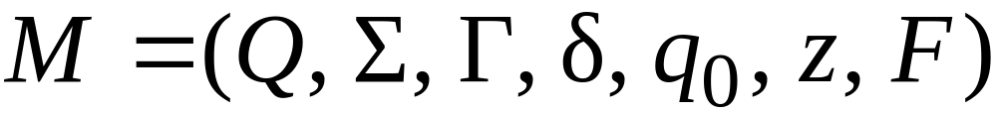
Formal Definition of NPDA
Non-Deterministic Pushdown Automaton
(NPDA) is a 7-tuple
Final
states
States
Input
alphabet
Stack
start
symbol
Transition
function
Initial
state
Stack
alphabet

Slide 9
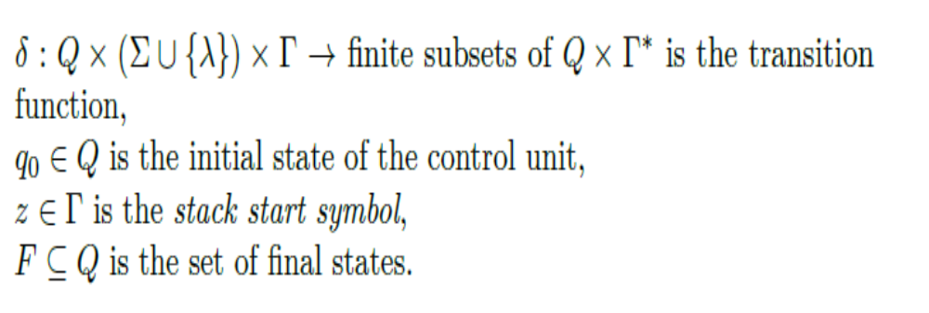
Non-Deterministic Pushdown Automaton
NPDA

Slide 10

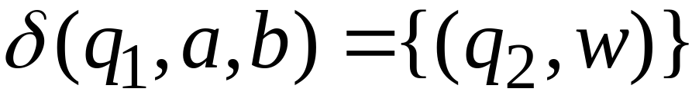
Non-Deterministic Pushdown Automaton
NPDA
Note that the input and stack alphabets may differ and that start stack symbol z must be an element of .
Consider the transition function
For example:

Slide 11
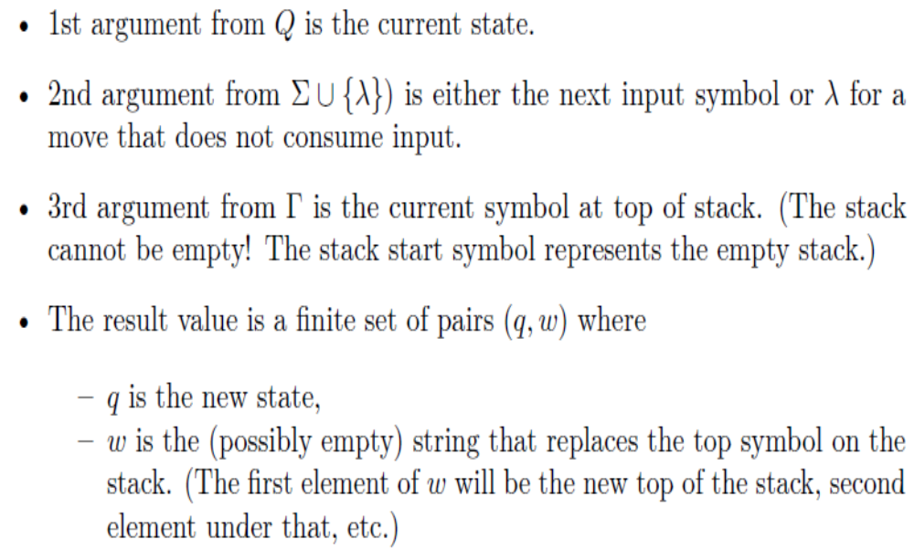
Transition function in NPDA

Slide 12

Transition function in NPDA
Each transition
is based on the current input symbol and the top of the stack
optionally pops the top of the stack, and
optionally pushes new symbols onto the stack.
Initially, the stack holds a special symbol Z that indicates the bottom of the stack
Note: (i) Some books use (null) as a symbol to indicate stack bottom. It is more explicit if we start with a stack bottom symbol, “Z” (ii) In a “push” operation, it is allowed to pop & push multiple symbols at the same time.

Slide 13


Transition function in NPDA
Transition function
can be represented by a Transition diagram or graph
a,b/w
A transition from q₁ of the form a, b / w
means “If from state q_{1 ,} the current input symbol is a and the current stack symbol is b, then follow this transition, pop b, push the string w and make a transition to state q₂
Note: The book uses a,b,w instead of a, b / w. Both notations are acceptable.

Slide 14
Constructing a Pushdown Automata
Constructing a PDA is algorithmic by which you find a procedure to accept all possible strings that belong to the language. (Keep in mind that a PDA can scan strings from left to right and can make use of an external stack storage)
Develop the transition diagram starting with the initial state q₀. with a stack bottom of “Z”. (Stack bottom is not necessary as we can assume as the stack bottom)
Define all possible actions/transitions from a state on all possible input symbols and stack top symbols. (read the input or push to stack or pop from stack)
Introduce nondeterministic transitions if required .
Complete the transition diagram and specify the final state so that it accepts all possible strings in the language.

Slide 15
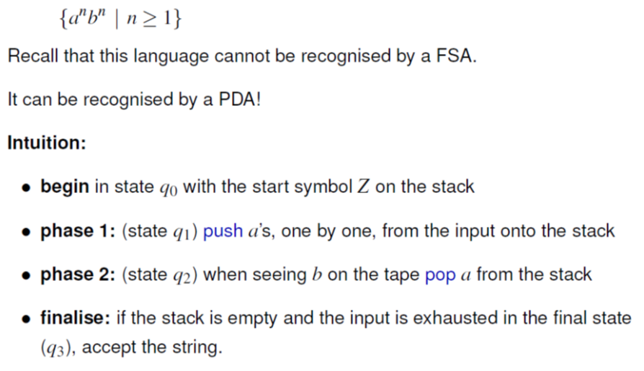
Example
L=

Slide 16
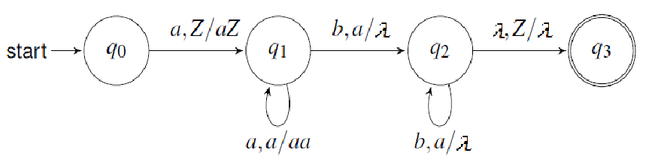

Example (continued)
The state transition diagram is
The complete description of the PDA is:
({q₀,q₁,q₂,q₃},{a,b},{a,b,Z}, ,q₀,Z,{q₃})
(This is a deterministic pda (DPDA) as there was only one choice of transition from any state.)

Slide 17
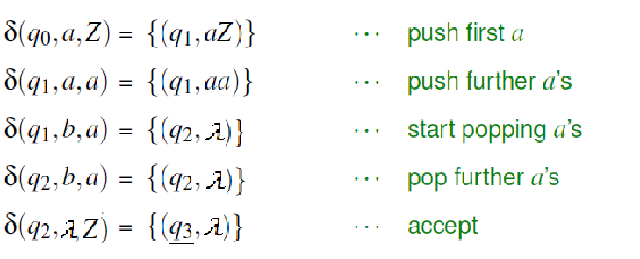
Example (continued)
The state transition function is given below:

Slide 18
Accept or Reject
•If the machine reaches final state q₃ with no unprocessed input using any possible sequence of transitions, then the machine accepts the input string. (In a DPDA, there is a unique path from the initial state to the final state on a string)
•If after processing the input string, no sequence of possible transition reaches a final state or if no move is defined then the machine rejects the input string.

Slide 19
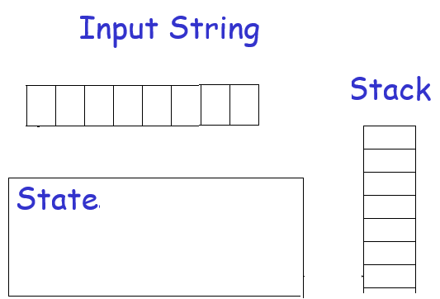
Example

Slide 20
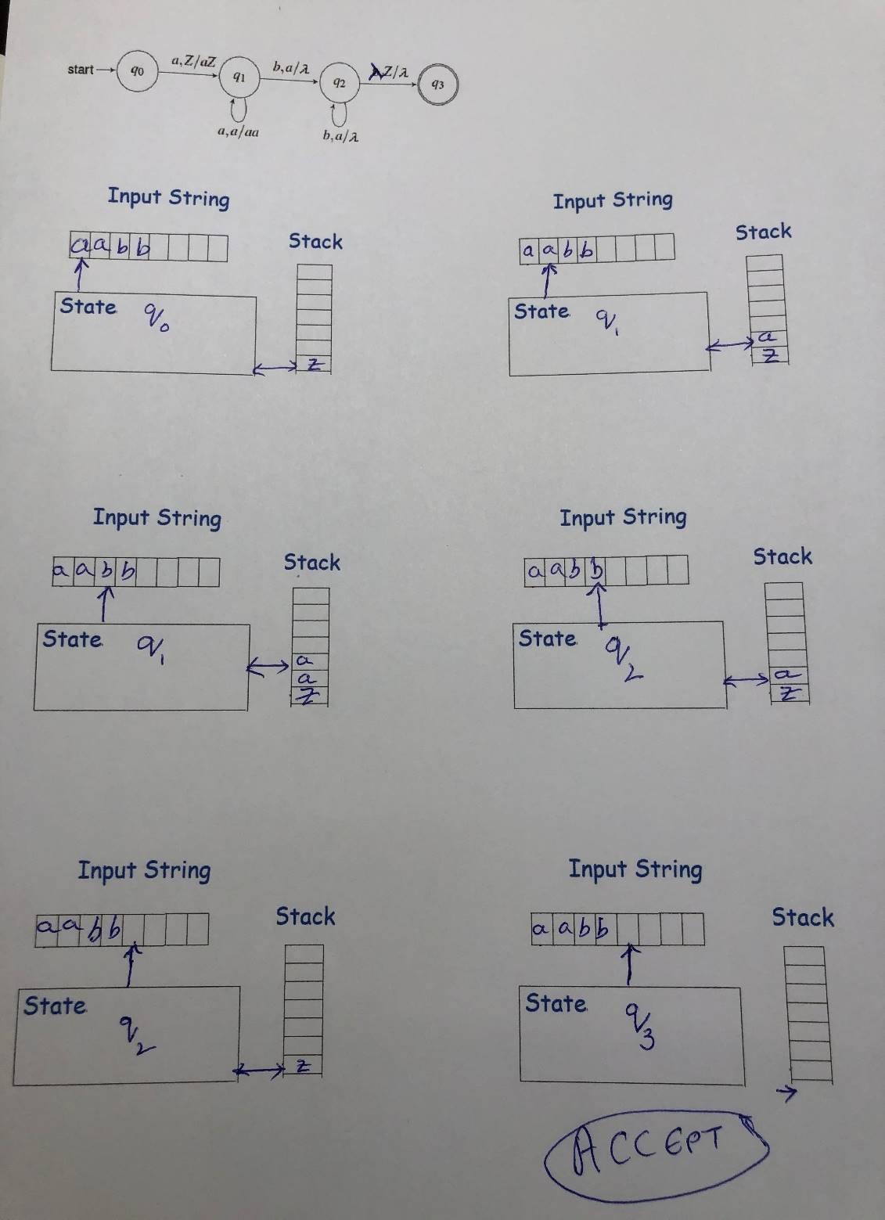
Example: Input = aabb

Slide 21
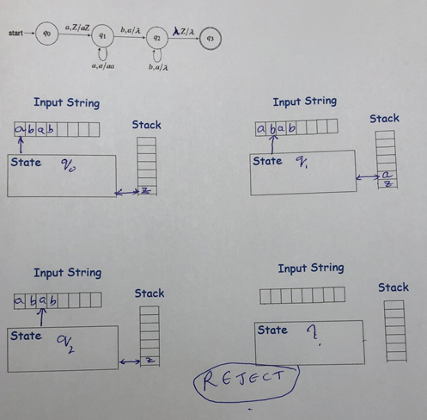
Example: Input = abab

Slide 22


Instantaneous Descriptions of Pushdown Automata
we use a concise notation for describing configurations of pushdown automata.
The triple (q, w, u) is called an instantaneous description of a pushdown automaton.
where
q is the control unit state
w is the unread input string
u is the stack as string, beginning with the top symbol
We introduce the symbol to denote a move from one instantaneous description to another such that
iff

Slide 23
Instantaneous Descriptions of Pushdown Automata
For the two previous examples:
Input = aabb;
(q₀,aabb,Z) (q₁,abb,aZ) (q₁,bb,aaZ)
(q₂,b,aZ) (q₁, ,Z)
(q₃, , ) Accept
(2) Input = abab;
(q₀,abab,Z) (q₁,bab,aZ) (q₂,ab,Z)
Reject
(no transition defined)

Slide 24

Nondeterministic Pushdown Automata
For the the previous example:
w is in the language if
(q₀,w,Z) ( ….. (q₃, , ) Accepting configuration
This definition of acceptance is valid as the pushdown automata is deterministic leading to unique configurations. (There is only one unique path from the initial state to the final state on a string that is accepted by the DPDA)
In general, a PDA is nondeterministic. The nondeterminism is critical as it adds power to the capability of a PDA and can represent languages that a deterministic PDA cannot.

Slide 25
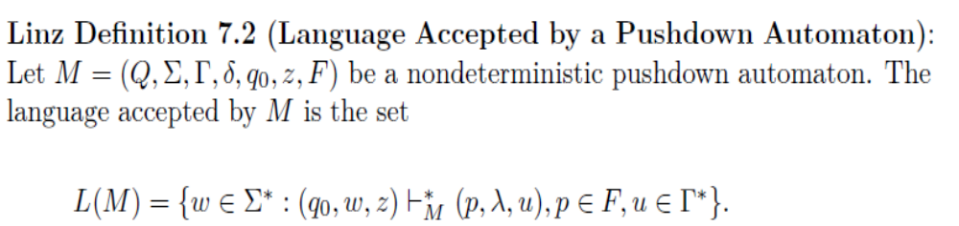
Nondeterministic Pushdown Automata
i.e., the language accepted by M is the set of all strings that can put M into a final state after processing the input string. (Since there are choices in transitions in an NPDA, a string is accepted if any one choice leads to acceptance)
The stack content is irrelevant to this definition of acceptance. However, most of the time the stack is empty at acceptance state.

Slide 26

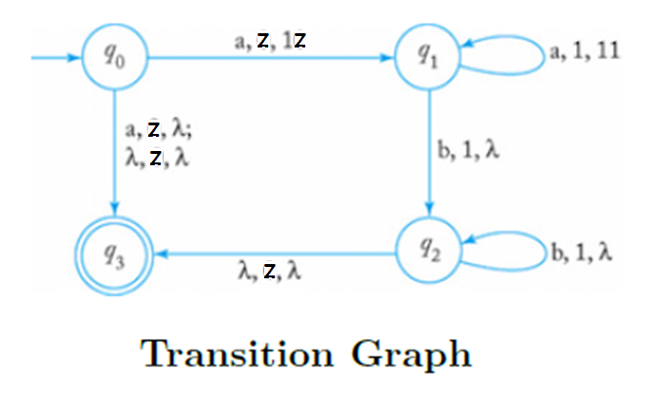
NPDA Example 7.3 (Textbook)
This is a slightly modified example from Example 7.3 in the textbook which uses 0 as a stack bottom instead of Z that we are using)
Describe an acceptor for a language that accepts . single “a”, or a’s followed by equal number of b’s

Slide 27
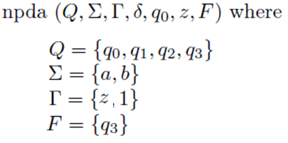
NPDA Example 7.3 (Continued)
Note:
The input symbols are a,b
Stack symbols can be different than the input symbols (unlike the previous example). The stack symbols are z,1 with z as initial stack bottom symbol. (Note that we could have used a’s instead of 1’s on the stack)
Initial state q₀ and the Final state q₃

Slide 28
NPDA Example 7.3 (Continued)
NPDA construction is as follows
(1) The first transition rule is nondeterministic, with choices for input symbol a and stack top Z.
The machine can push 1 on the stack and transition to state q1. (This is the only choice that will allow the machine to accept additional input.)
The machine can pop the stack symbol z and transition to final state q3. (This is the only choice that will allow the machine to accept a single a.)
(2) For stack top z, the machine can also transition from the initial state q0 to final state q3 without consuming any input. (This is only choice that will allow the machine to accept an empty string.) Note that rule 2 overlaps with rule 1, giving additional nondeterminism.

Slide 29
NPDA Example 7.3 (Continued)
(3) While the machine reads a’s, it pushes a 1 on the stack and stays in state q1. (The number of 1’s in the stack keeps count of the a’s scanned)
(4) When the machine reads the symbol b (with stack top 1), it pops the 1 from the stack and transitions to state q2.
(5) While the machine reads b’s (with stack top 1), it pops the 1 from the stack and stays in state q2.
(6) When the machine encounters the stack top Z, after processing all the b’s, it pops the stack symbol Z, and transitions to final state q3.

Slide 30
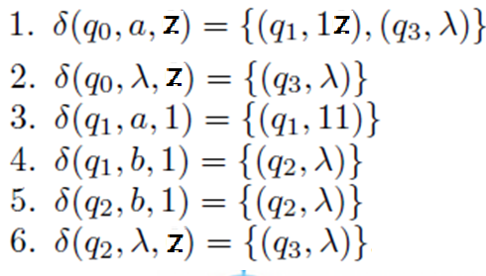
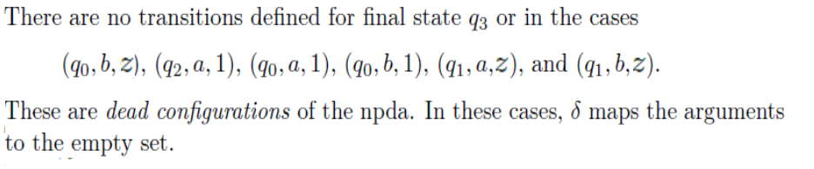
NPDA Example 7.3 (Continued)
Transition function

Slide 31
NPDA Example 7.3 (Continued)
•If the machine reaches final state q₃ with no unprocessed input using any (one) possible sequence of transitions, then the machine accepts the input string.
•If every sequence of possible transitions reaches a configuration in which no move is defined or reaches the final state with unprocessed input remaining, then the machine rejects the input string.

Slide 32
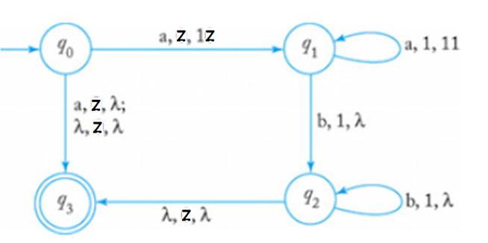
NPDA Example 7.3 (Continued)
Test if the npda accepts the input string: a
3 choices leading to three next configurations:

Slide 33
NPDA Example 7.3 (Continued)
Test if the npda accepts the input string: ab
Configuration sequences:

Slide 34

Example 7.4 (textbook)
Construct an npda for the language
We must count a’s and b’s, but their relative order is not important. We use 0’s to represent a’s and 1’s to represent b’s on the stack.
The basic idea is counting by putting symbols on stack.
If 0 is the stack top (i.e., we have either seen more a’s than b’s are matching number of a’s and b’s thus far)
on seeing an “a” on the input, count another “a” by pushing 0.
On seeing “b” on the input, pop 0 to decrement the count of a’s on the stack.
Similarly logic can be extended to all other possibilities.
This appears to be deterministic as unique transition are defined.

Slide 35
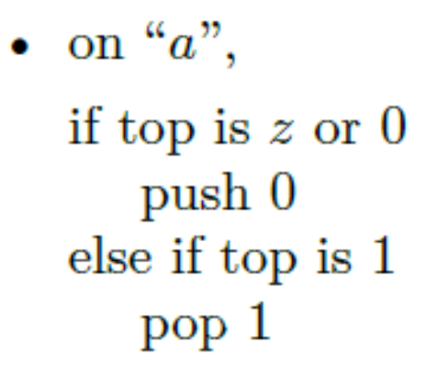
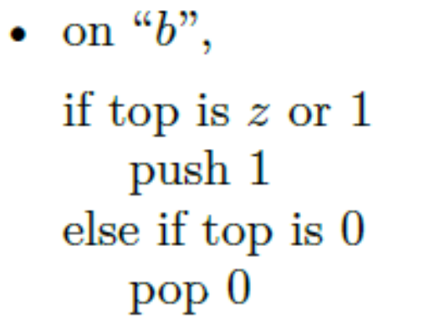
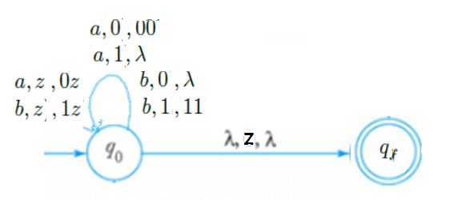
Example 7.4 (continued)

Slide 36
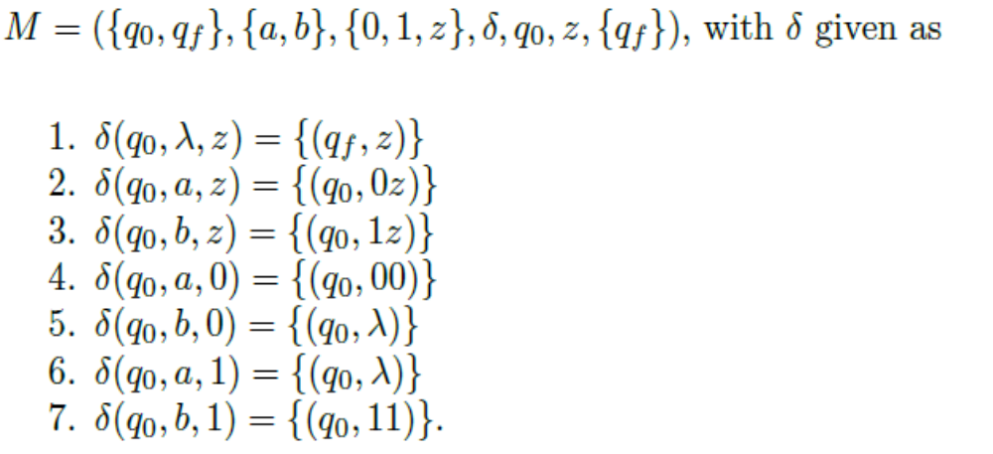
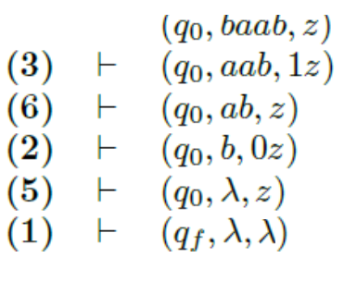
Example 7.4 (continued)
The npda is
In processing the string baab.
the configurations are:

Slide 37
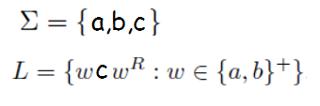
Palindromic Language Example
Construct a PDA for accepting the palindromic language L.
The idea is very simple and is deterministic.
Push input symbols (“a” or “b”) from w on stack from initial state q₀.
Transition to next state q₁ on seeing the middle “c”.
Pop symbols from stack for w^{R} (which is w right-to-left)
Transition to an accepting state q₂ on a successful match.

Slide 38
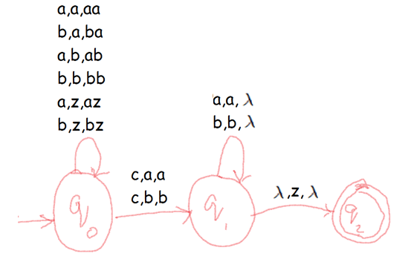
Palindromic Language Example (Continued)
The PDA is deterministic.
It accepts the strings: aca,abcba,aabacabaa,….

Slide 39
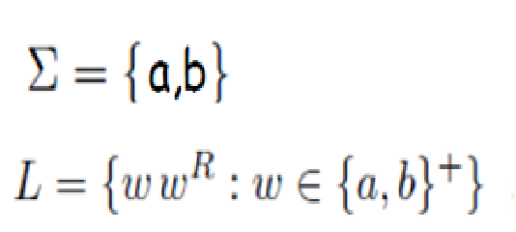
Example 7.5 (Textbook)
Construct a PDA for accepting the palindromic language L.
The idea seems to be similar to the prior example.
Push the first half and pop the latter half.
However, there is no explicit middle marker
How do we find the middle?
Solution: Use nondeterminism!
• Each symbol could be at middle.
• Automaton “guesses” when to switch.

Slide 40

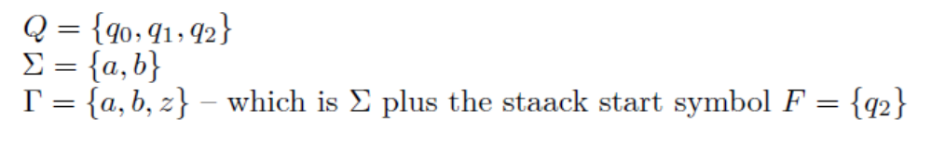
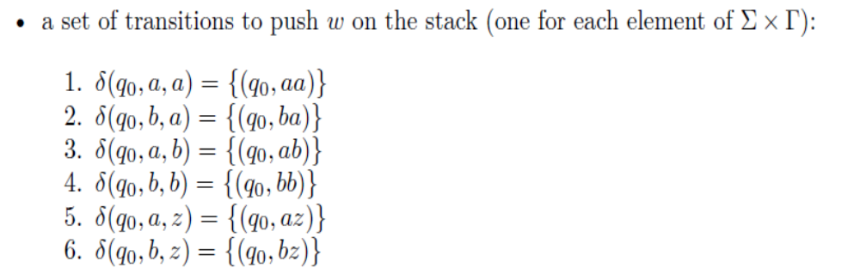
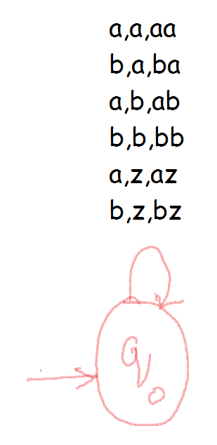
Example 7.5 (continued)
Solution: Define npda M =
The logic is defined in four parts in the way transition function is defined

Slide 41
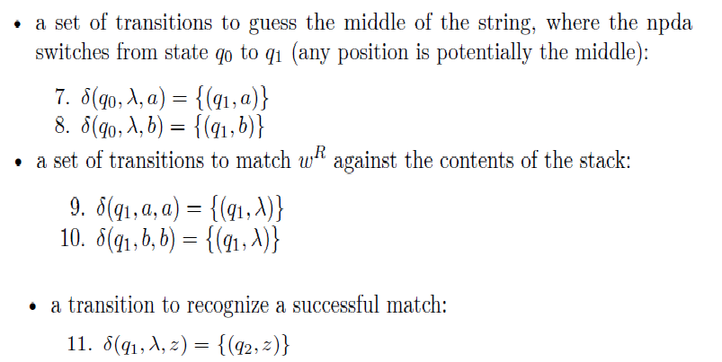
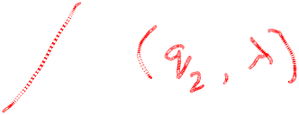
Example 7.5 (continued)

Slide 42
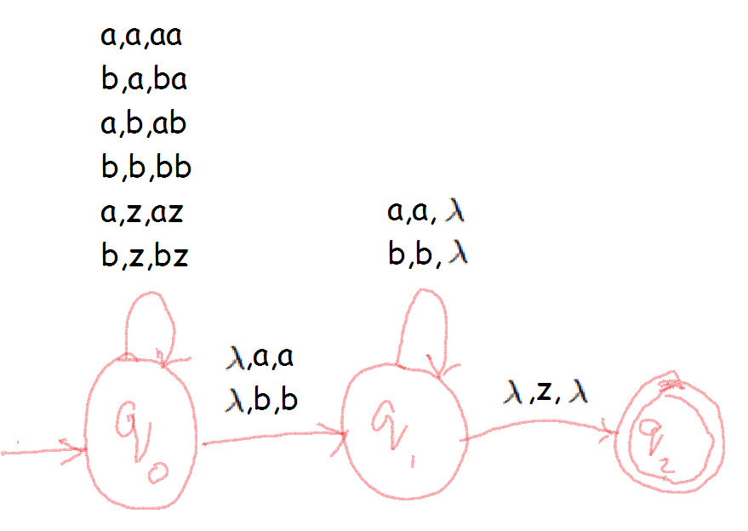
Example 7.5 (continued)
This ndpa accepts all palindromic strings: aa,abba,…
Note that the string belongs to the language if any one choice (because of nondeterminism) leads to acceptance.

Slide 43
More Examples
Construct a PDA for accepting the language
L = {a^{n}b^{m} | n and m are both >0 }
n=m; Considered earlier
n=2m; Modify (i) by popping 2 a’s for each b
m=2n; Modify (i) by pushing 2 a’s for each a
m<=n<=2m;
  Cannot find a deterministic solution.
    For example, need to accept aabb, aaabb, aaaabb
  Needs a nondeterministic solution that combines the solutions of (i) and (ii)

Slide 44
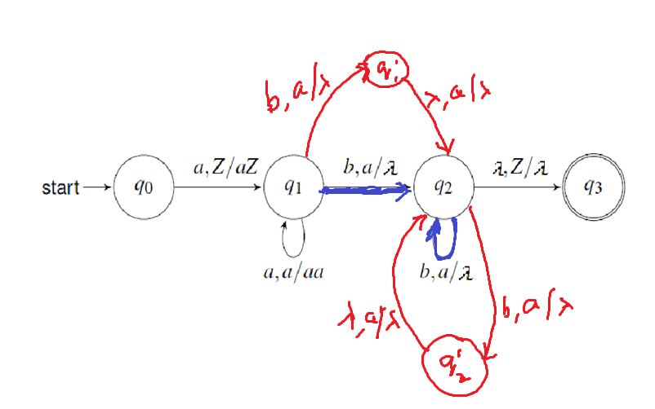
More Examples (Continued)
Construct a PDA for accepting the language
L = {a^{n}b^{m} | n and m are both >0 }
m<=n<=2m;
To account for all possibilities, pop an “a” [solution for (i)] or pop 2 “a”s [solution for (ii)] resulting in this transition diagram

Slide 45


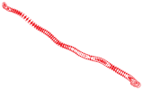
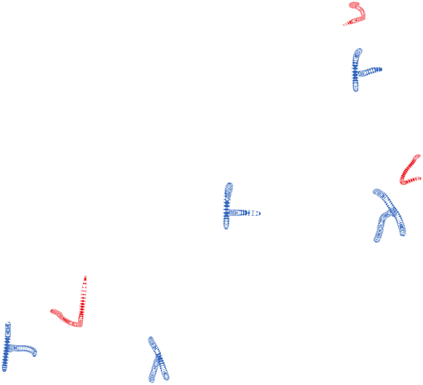

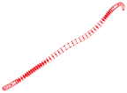

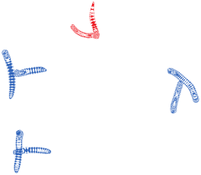

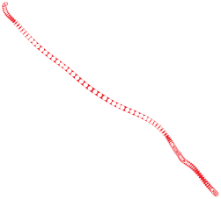
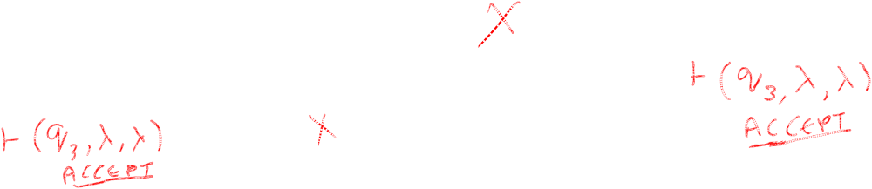


More Examples (Continued)
(q₀,aaabb,z)
(q₁,aabb,az)
(q₁,abb,aaz)
(q₁,bb,aaaz)
(q’₁,b,aaz) (q₂,b,aaz)
(q₂,b,az)
(q₂, ,az) (q’₂, ,az)
(q₂, ,z) (q₂, ,z) (q’₂, ,z)

Slide 46
(1)Give the step by step transitions (showing input and stack at each step) and give the Instantaneous description of the Automata for the language
(considered in the slides) on the input strings
(i) baab (ii)abaabbba (iii) aab (iv) b
(2) For the language, L = {a^{n}b^{m}}
Construct a PDA for the following assuming that both n and m are >=0:
(i) n<m (ii)n>m (iii) n>=m (iv) n=2m
(Show one configuration sequence leading to acceptance and one configuration sequence leading to rejection on strings of length >4)
(3) Do exercises 1,2, 3 (a,b), 6 (a thru h)
For a NPDA, show all the choices as in the last example.
(Show one configuration sequence leading to acceptance and one configuration sequence leading to rejection on strings of length >4)
Homework 7.1

Slide 47
(4)Construct a PDA for the following
Give a complete description as a 7-tuple
Show one configuration sequence leading to acceptance and one configuration sequence leading to rejection on strings of length >4)
(i) L = {a^{i}b^{j}c^{k} |i = j + k and i,j,k are all greater than 0}
(ii) L = {a^{i}b^{j}c^{k} |j = i + k and i,j,k are all greater than 0}
(iii) L = {a^{i}b^{j}c^{k} |i >= j + k and i,j,k are all greater than 0}
Homework 7.1

